Slide 1



The Power of AI in English Language Learning
Discover how cutting-edge AI technology is transforming the way students learn English. With Aria AI, students have access to personalized learning tools that adapt to their needs, track progress, and enhance engagement.
by Muhammed Ismailov IT 1-22

Slide 2
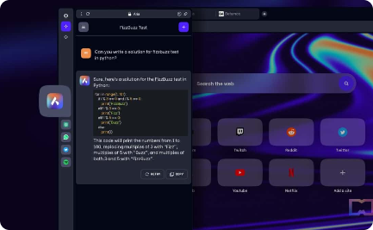


Introducing Aria AI: The Future of Language Learning
Seamless Integration
Smart Toolset
Engaging Activities
Aria AI integrates seamlessly with all major browsers and devices, making learning English easy and accessible for everyone.
The AI-powered toolset includes grammar and vocabulary checkers, pronunciation support, and even writing prompts for practice.
From listen-and-repeat exercises to interactive games, Aria AI offers a variety of engaging activities that keep students motivated and on track.

Slide 3
Research-Backed Benefits of AI in Language Learning
Better Retention
Increased Confidence
Research shows that students who use AI-powered language learning tools retain more information and make better progress compared to traditional methods.
With personalized feedback and support, students using Aria AI are more likely to feel confident in their abilities to speak, write, and comprehend English.
Efficient Learning
Flexible Learning
Aria AI's adaptive learning system tracks progress and identifies areas for improvement, resulting in more efficient use of study time and faster progress.
With Aria AI, students can learn anytime, anywhere, at their own pace and with content tailored to their skill level and goals.

Slide 4
Elevating the English Language Learning Experience
1
Step 1: Onboarding
Students create their profile, set goals, and take a placement test to determine their skill level.
Step 2: Learning with Aria AI
2
Students engage with various learning tools and activities, while the AI-powered system tracks their progress and adapts to their needs.
3
Step 3: Personalized Feedback
Aria AI provides personalized feedback on areas of strength and weaknesses, and offers tailored recommendations for further learning.

Slide 5

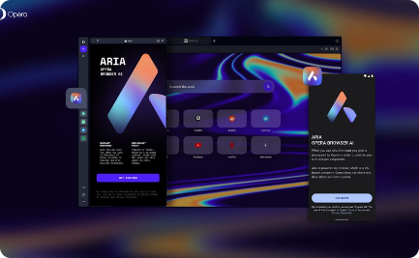
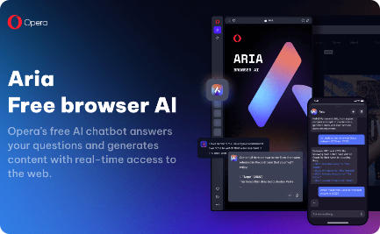
Stellar Student Reviews of Aria AI
"Aria AI Rocks!"
"The Best English Learning App"
"Game-Changing Technology"
"I have never felt so confident speaking English. Aria AI has transformed the way I learn and practice!"
"Aria AI is so easy to use, and the personalized support makes learning fun and engaging. Highly recommend!"
"I can't believe how much my English has improved thanks to Aria AI. It's truly the future of language learning."

Slide 6

Future Trends in English Learning with AI
1
Virtual Reality Learning
2
Real-Time Conversation Support
3
Global Accessibility
With VR technology advancing rapidly, it's only a matter of time before students can immerse themselves in realistic language scenarios, accelerating comprehension and learning.
AI will bridge language and cultural barriers and provide more opportunities for international language exchange, helping students learn from experts and peers around the world.
As AI technology improves, we can expect to see even more advanced conversation support tools that provide instantaneous language feedback and suggestions.

Slide 7

Unlock Your Potential with Aria AI
Experience the revolutionary power of AI in English language learning with Aria AI. Download the extension to Opera Browser and start your language learning journey today!

